Slide 1
What to do about DUID?
A National Perspective on Drugged Driving Laws
Candace Lighter & James Evans

Slide 2
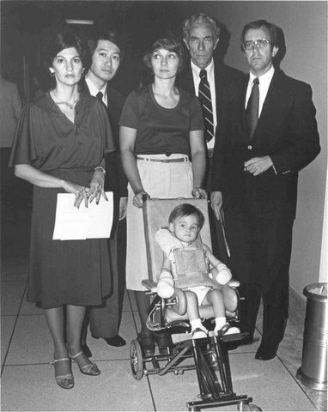
Origins of a Movement
The Anti-drunk driving movement put a face on the statistics.
“Boots on the ground” formed in almost every state.
1980 -1985 more than 2,000 impaired driving bills were past at the state and federal level.
DUI fatalities were reduced by more than 20%.

Slide 3
Origins of a Movement
The drinking age was raised to 21 in every state through incentive grants
despite tremendous opposition from the alcohol industry and students.
Most importantly, Drunk driving became socially unacceptable.

Slide 4
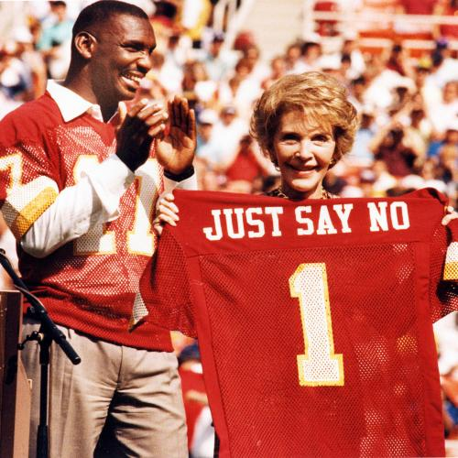
“Just Say No” is Over
The pro marijuana movement is well financed, well organized and more adept at promoting their ongoing theme that “The prohibition of marijuana is an utter failure”
They often site studies with no source information to support their claims and counter legitimate studies by accredited
researchers.
The attitudes that surround drug use have changed dramatically, as have the attitudes towards punishment and criminal justice since the 1990s. The theme now is to “reduce the jail population” causing the decriminalization of other crimes as well.

Slide 5
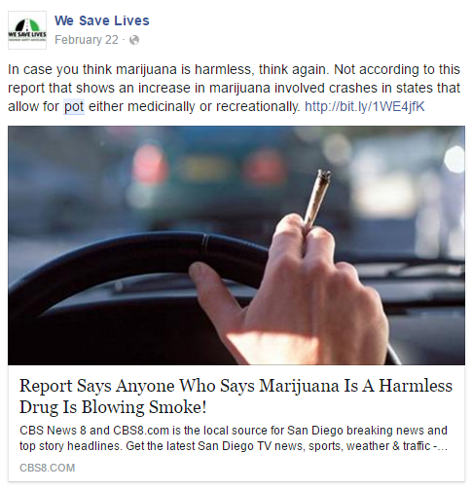
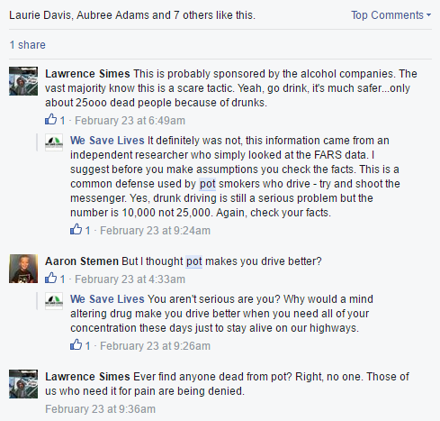
Public reaction in the age of marijuana
The social media reaction reveals poor communication & the lack of information
MADD dealt with accusations of prohibitionism, but alcohol wasn’t simultaneously fighting for its legitimacy within society.

Slide 6
Weed Advisor

Slide 7
Facebook responses to WSL posts…
“This is probably sponsored by the alcohol companies. The vast majority know this is a scare tactic. Yeah, go drink, it's much safer...only about 25ooo dead people because of drunks.”
“But I thought pot makes you drive better?”
“Ever find anyone dead from pot? Right, no one. Those of us who need it for pain are being denied.”
“Idk about you guys but im much more alert when i dive under the influence”
“alcohol also kills people if you consume too much, marijuana doesn't... Stop trying to compare alcohol to marijuana cause they're not the same.”
“I'm surprised that this ridiculous myth of weed causing traffic accidents like alcohol is still prevalent”

Slide 8
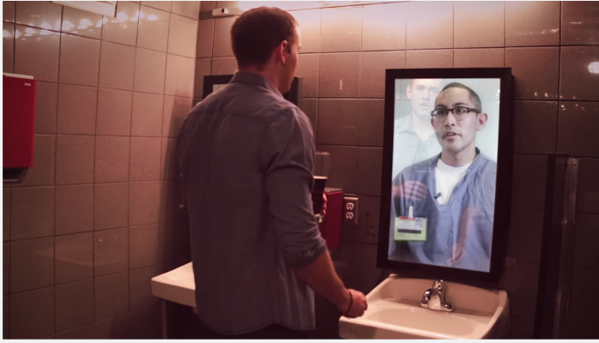
But When it is About Drunk Driving . . .
#RefelectionsfromInside
Anti-Drunk Driving Video recently posted by We Save Lives.

Slide 9
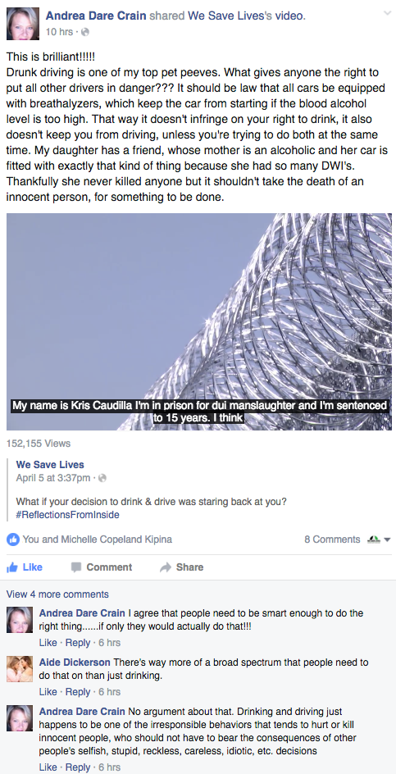
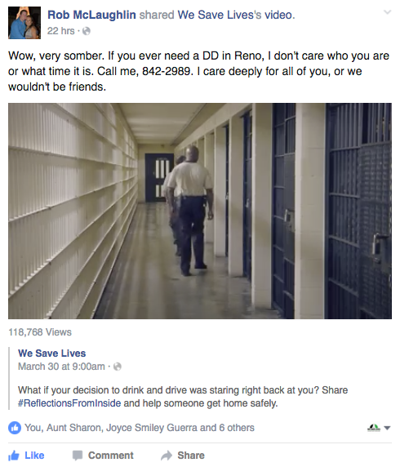
Facebook Responses to WSL Post

Slide 10
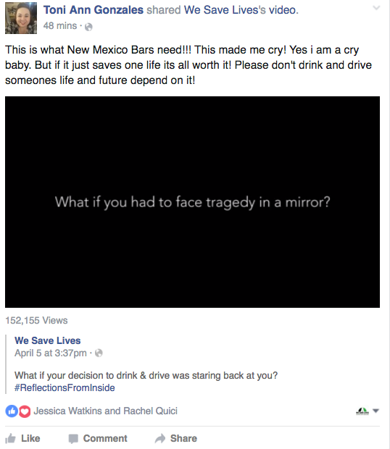
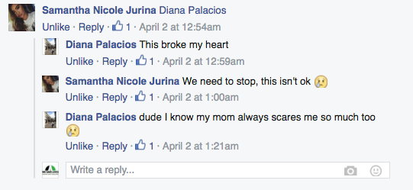

Slide 11
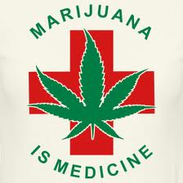
Cannabis is Not Only Socially Acceptable but . ..
medically necessary for all kinds of ailments
“makes you drive better?”
become “more inventive, artistic and innovative.”
“help you blossom into a talkative, outgoing person”
“bring a temporary giddiness that allows you to escape
from your normal day-to-day happenings and make you
feel like a kid again”
“energize your senses”
Source:http://bit.ly/1S9edbI

Slide 12
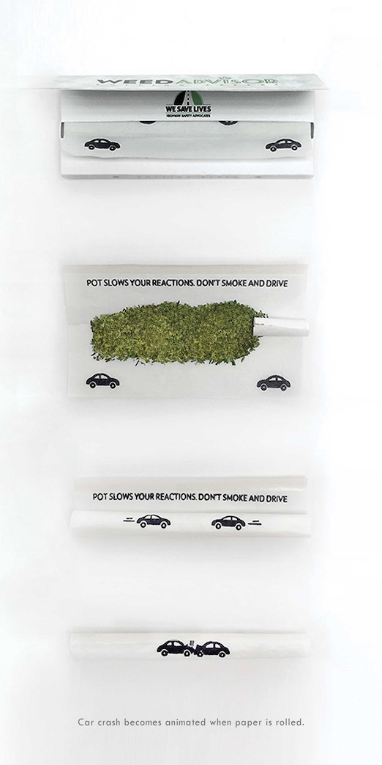
What is wrong with the Anti-DUID Movement Today?
There isn’t one –it’s not a problem
Lack of Data, stats and reliable numbers
Lack of testing by law enforcement
Lack of prosecution (they don’t want to lose)
Lack of education
Lack of PSA’s – public education
Lack of media interest - they all smoke
Lack of government support
Very “few boots on the ground”
No public face for the stats

Slide 13
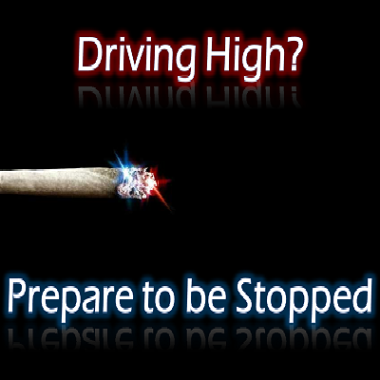
As a result
Drugged drivers frequently escape prosecution which means –
No conviction which means –
No punishment or accountability which means –
No rehabilitation which means –
No justice for the victim/survivor
No protection for society

Slide 14
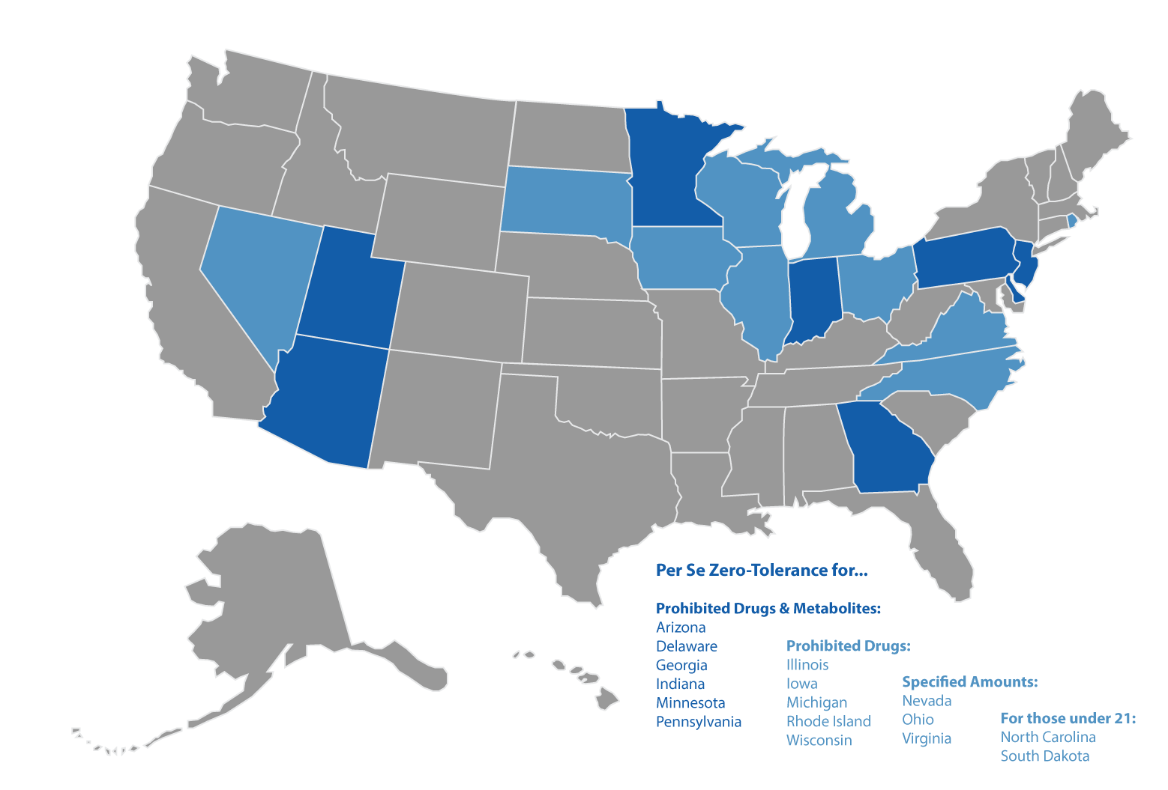
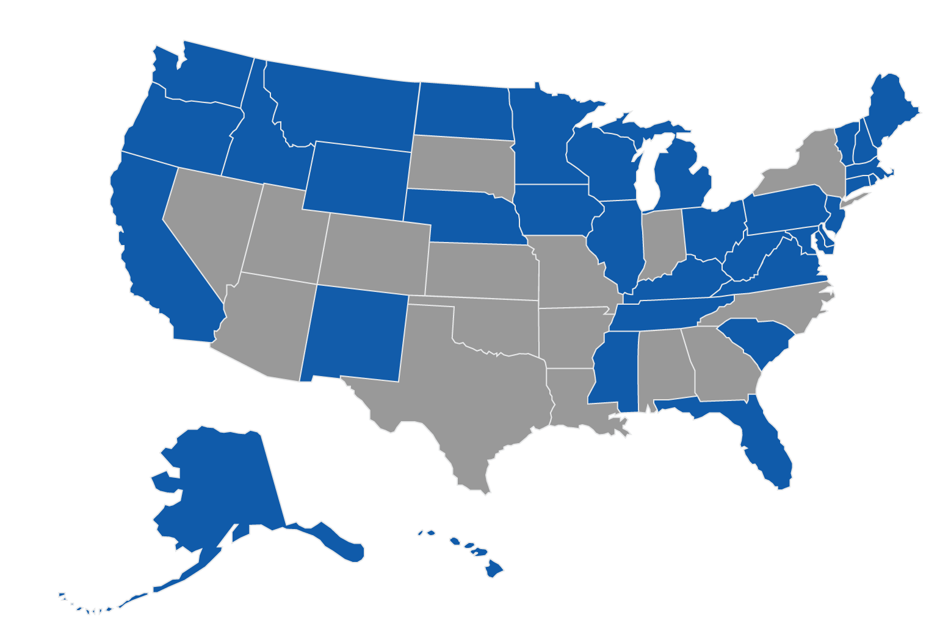
DUID Laws (WeSaveLives.org & StopDUID.org)
Per Se
Oral Fluids

Slide 15
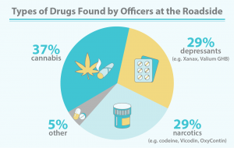
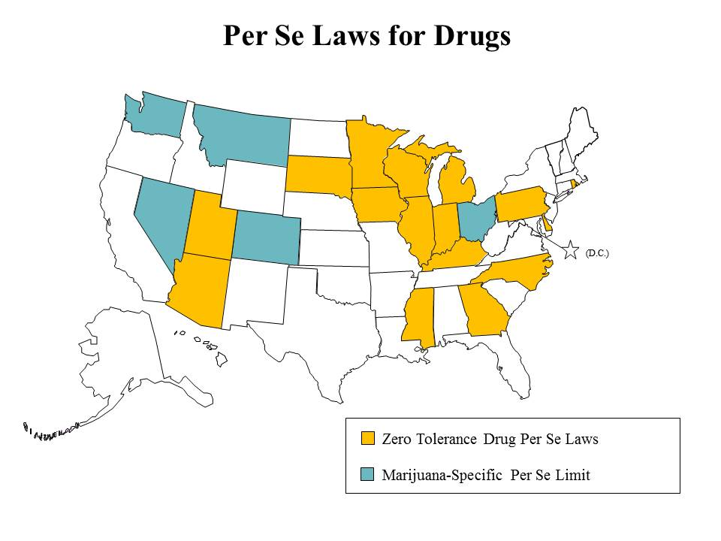
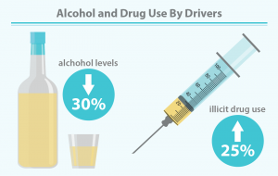
DUID Laws
Source: AAA
Map

Slide 16
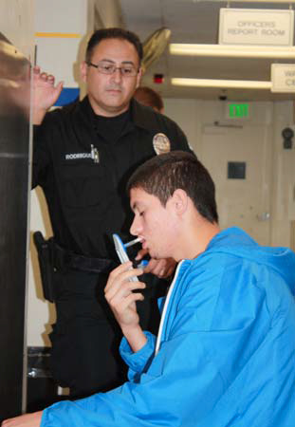
Solutions
Separate DUI alcohol and DUID statute citation numbers
Use oral fluid devices to quickly and more effectively test for drug presence, preferably at the roadside, as is done with breath testing for alcohol.
Implement mandatory testing of all (surviving and deceased) drivers involved in crashes that result in death or serious bodily injuries.
Provide additional training for and use of Drug Recognition Experts (DREs and officers trained in Advanced Roadside Impaired Driving Enforcement (ARIDE) since most officers are not qualified to identify drugged drivers.
Reduce delays in collecting blood samples through the use of electronic warrants.
Source: http://wesavelives.org/ask-congress-to-stop-duid/

Slide 17
Solutions or Law Recommendations
Enhance penalties for driving under the influence of combinations of drugs or drugs plus alcohol, recognizing that combinations of drugs can be more impairing than drugs individually
Implement effective treatment programs such as the 24/7 sobriety program for chronic offenders of both alcohol and drugs.
Adopt per se laws to facilitate drugged driving prosecution as alcohol per se laws do for drunk driving prosecution.
Revise 23 US Code § 405 (d) that specifies grants to States that implement impaired driving countermeasures. There are specific grants to States to reduce alcohol impairment (such as grants to adopt and enforce mandatory alcohol-ignition interlocks) but none for drugged driving impairment
Source: http://wesavelives.org/ask-congress-to-stop-duid

Slide 18
State Snapshots
California
Chairman wouldn’t support it unless we removed the THC provision, which we didn’t agree to so the bill didn’t pass.
Colorado
Sponsor refused to yield to toxicological advice…
Was eventually indicted for corruption…
New Hampshire
Eventually got nabbed for large scale drug possession and soliciting a minor online
Legislator engaged in heated email exchange about his own THC use

Slide 19
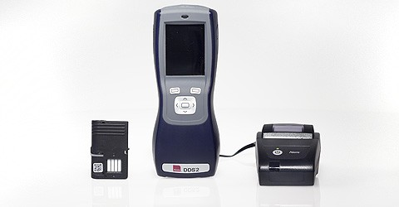
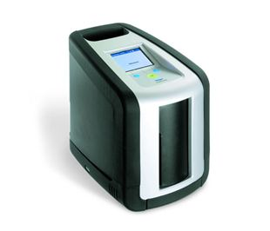
Technologies available…
Source: We Save Lives

Slide 20
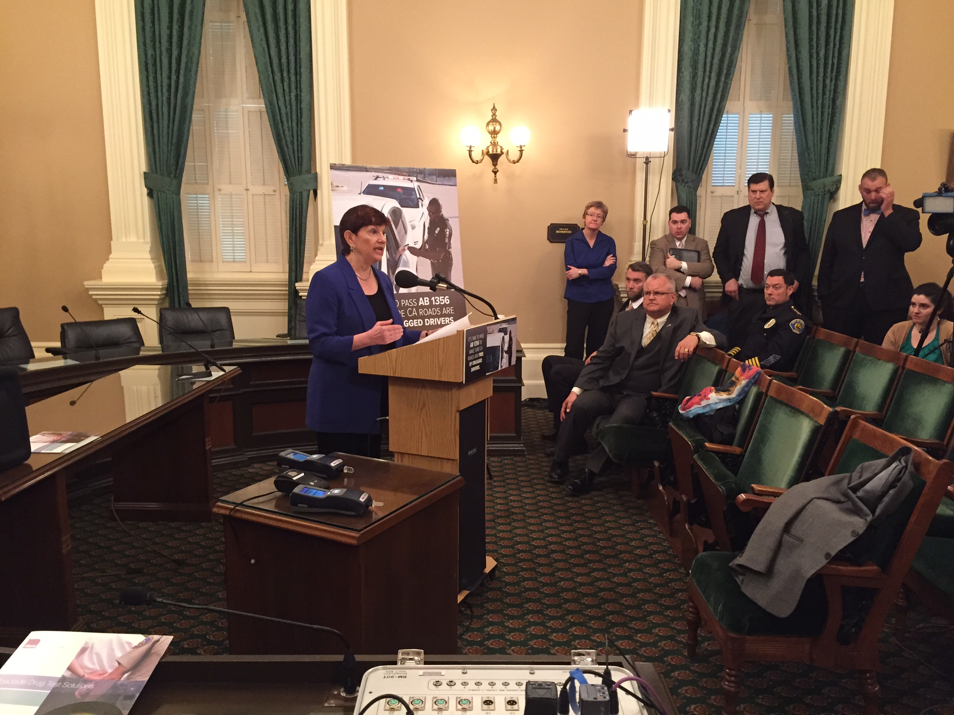
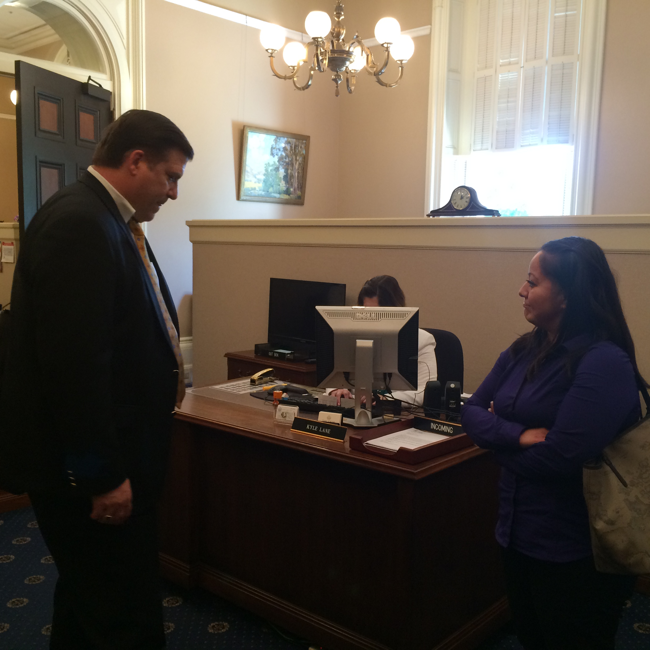
How are we doing it…
Not well
Providing Resources, Talking Points, Expert testimony
Letter writing campaign to all legislators
We Save Lives, partner org. building coalitions such as in Illinois and Colorado
Advocacy - personal visits to the committee members
Social Media
Press conferences
Blogs, i.e. http://wesavelives.org/britain-solving-drugged-driving-problem/

Slide 21
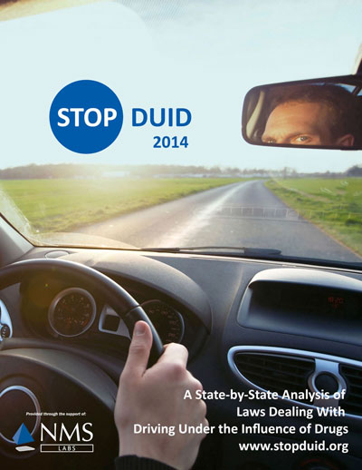
State-by-State Report
Get your copy at www.StopDUID.org/report.html!
2016 version in production for this summer, including new questions.

Slide 22
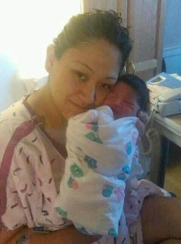
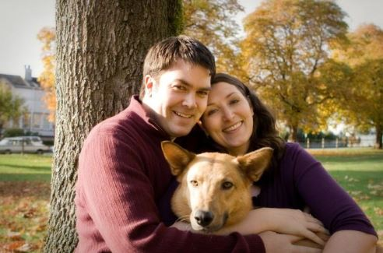
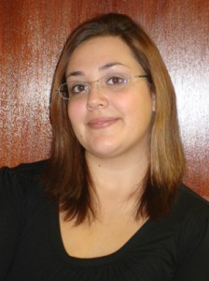
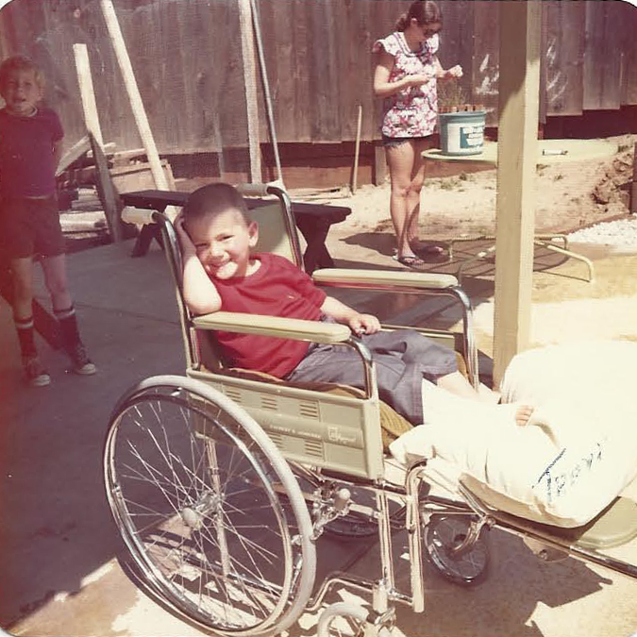
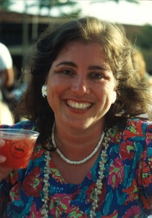
Why we do it…

